Slide 1
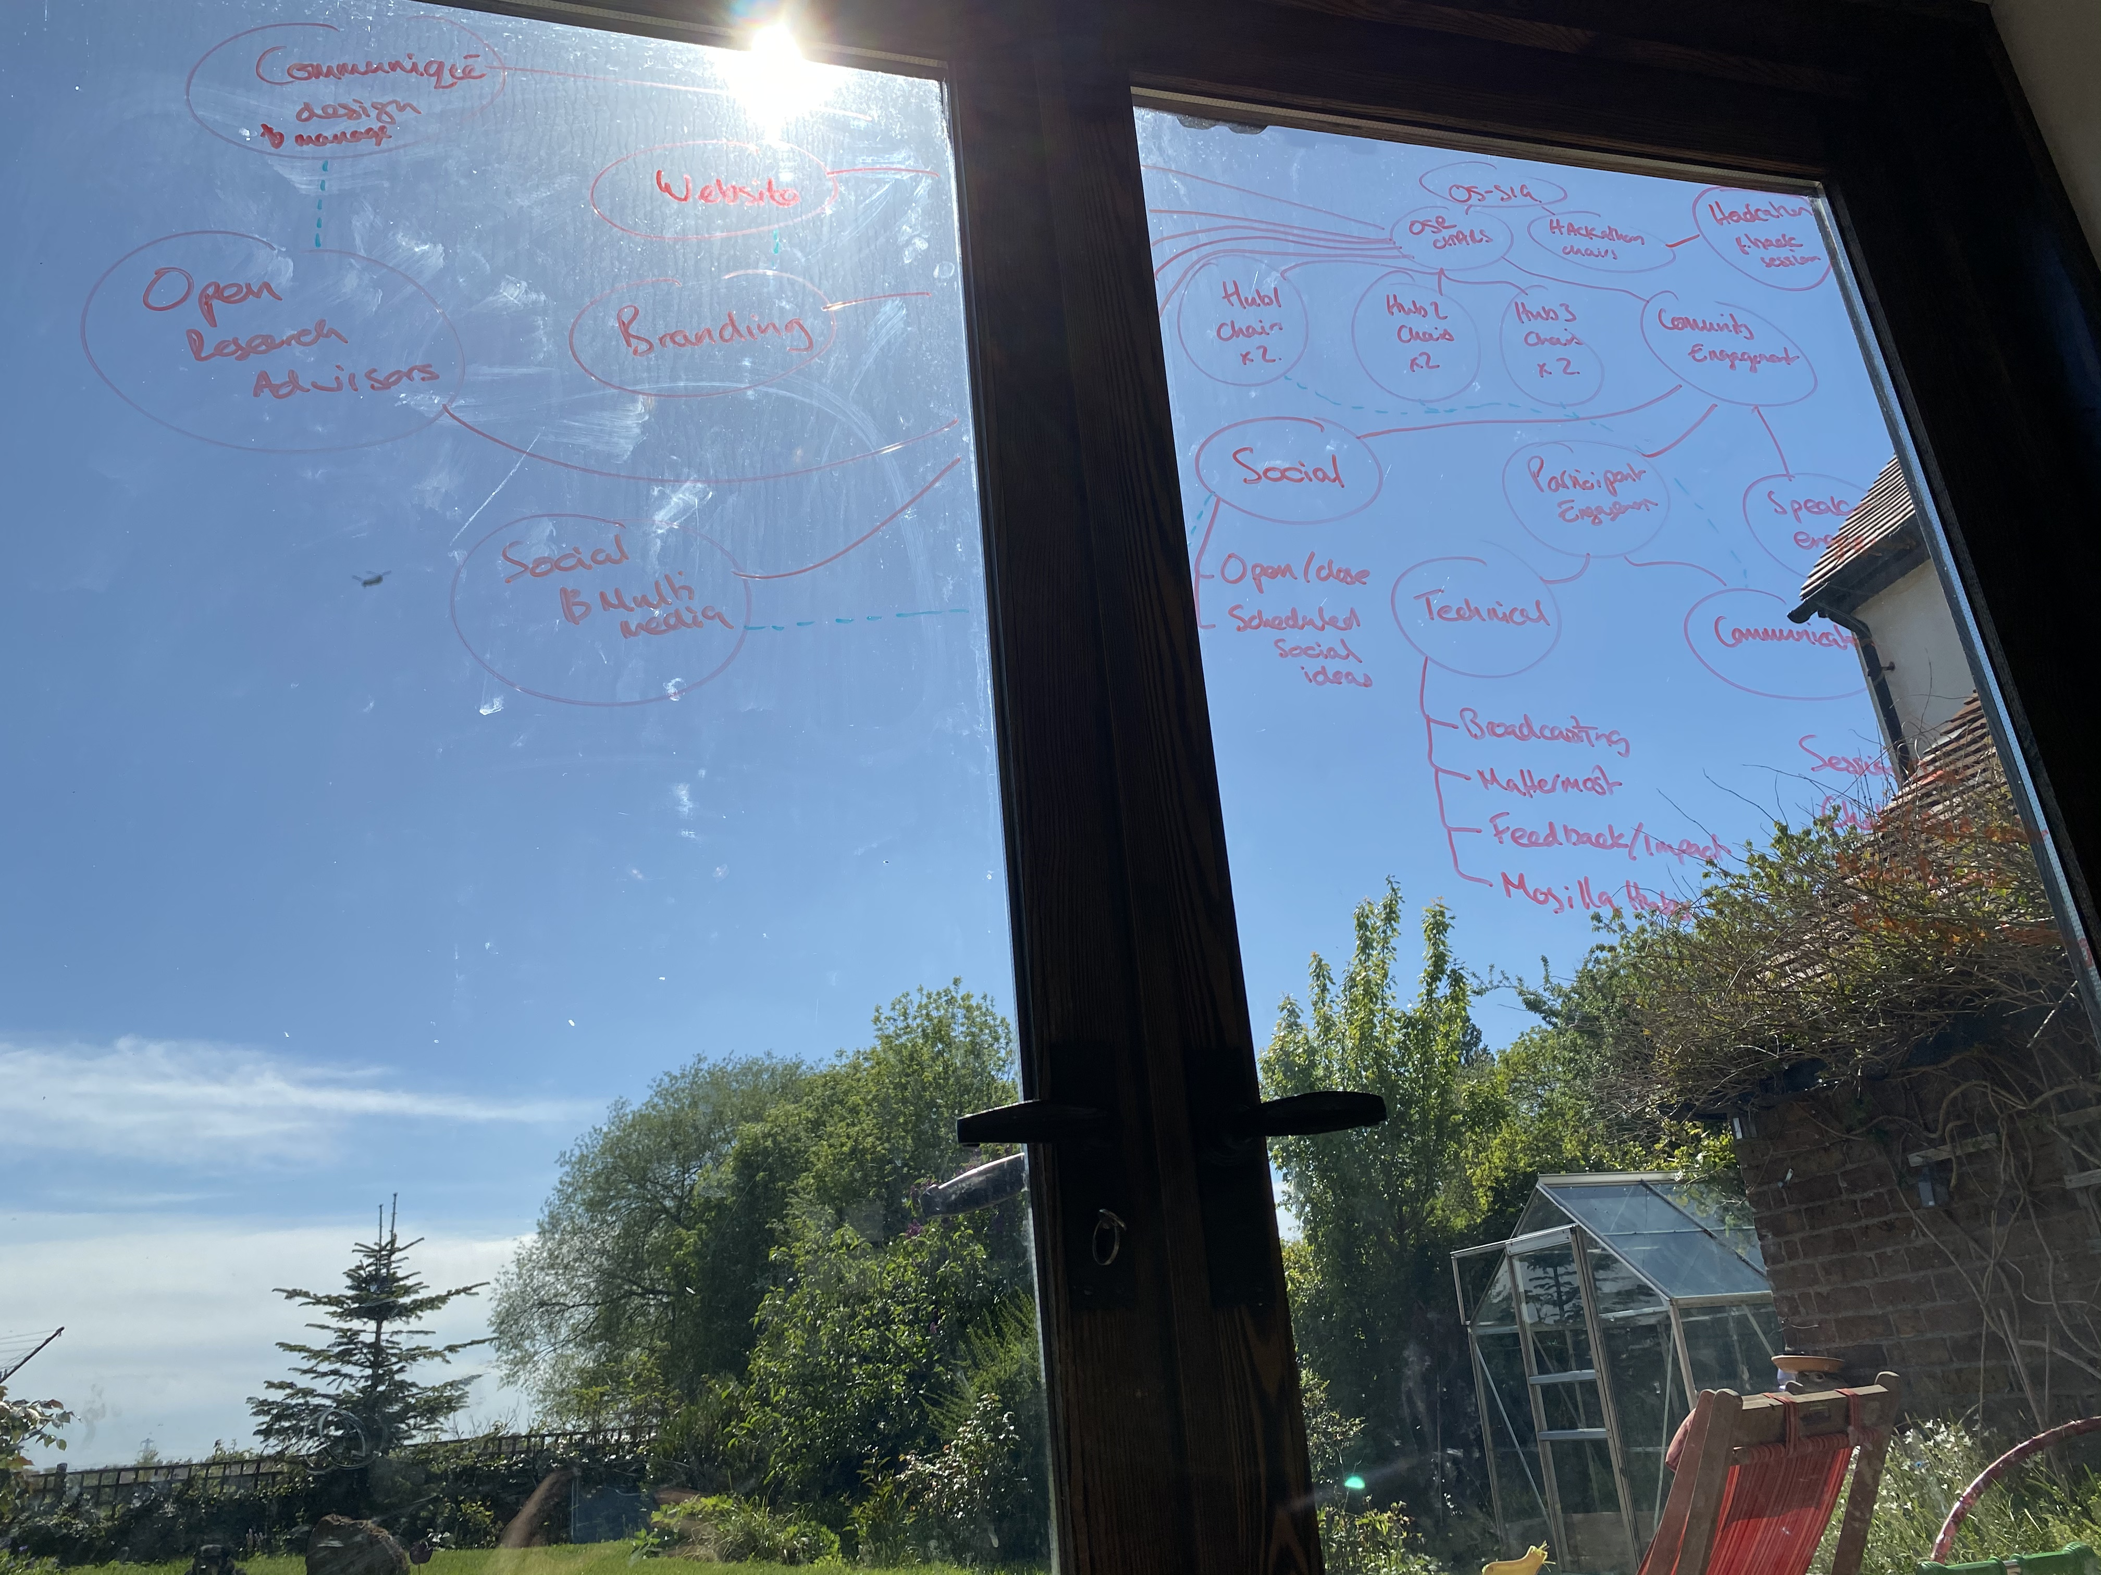

Slide 2
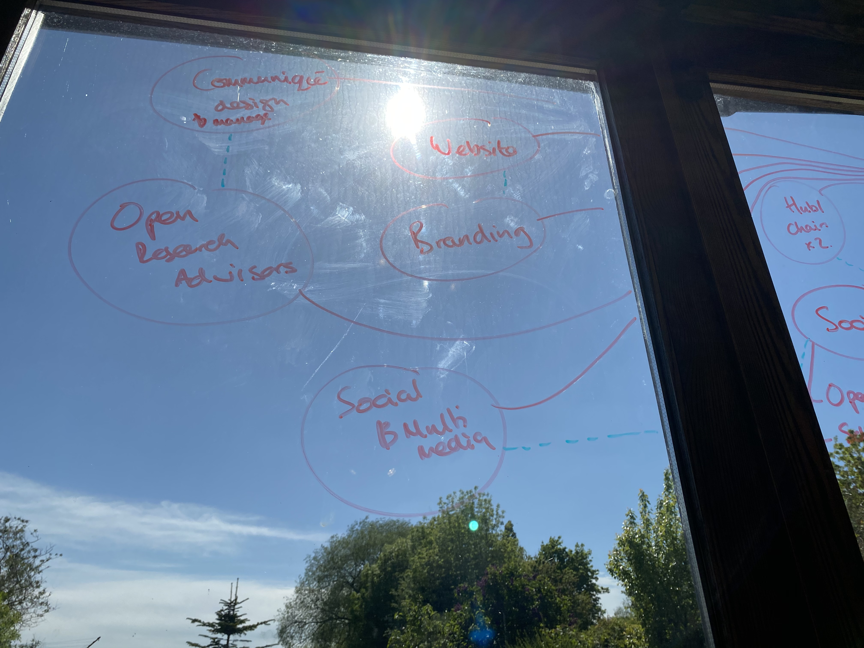
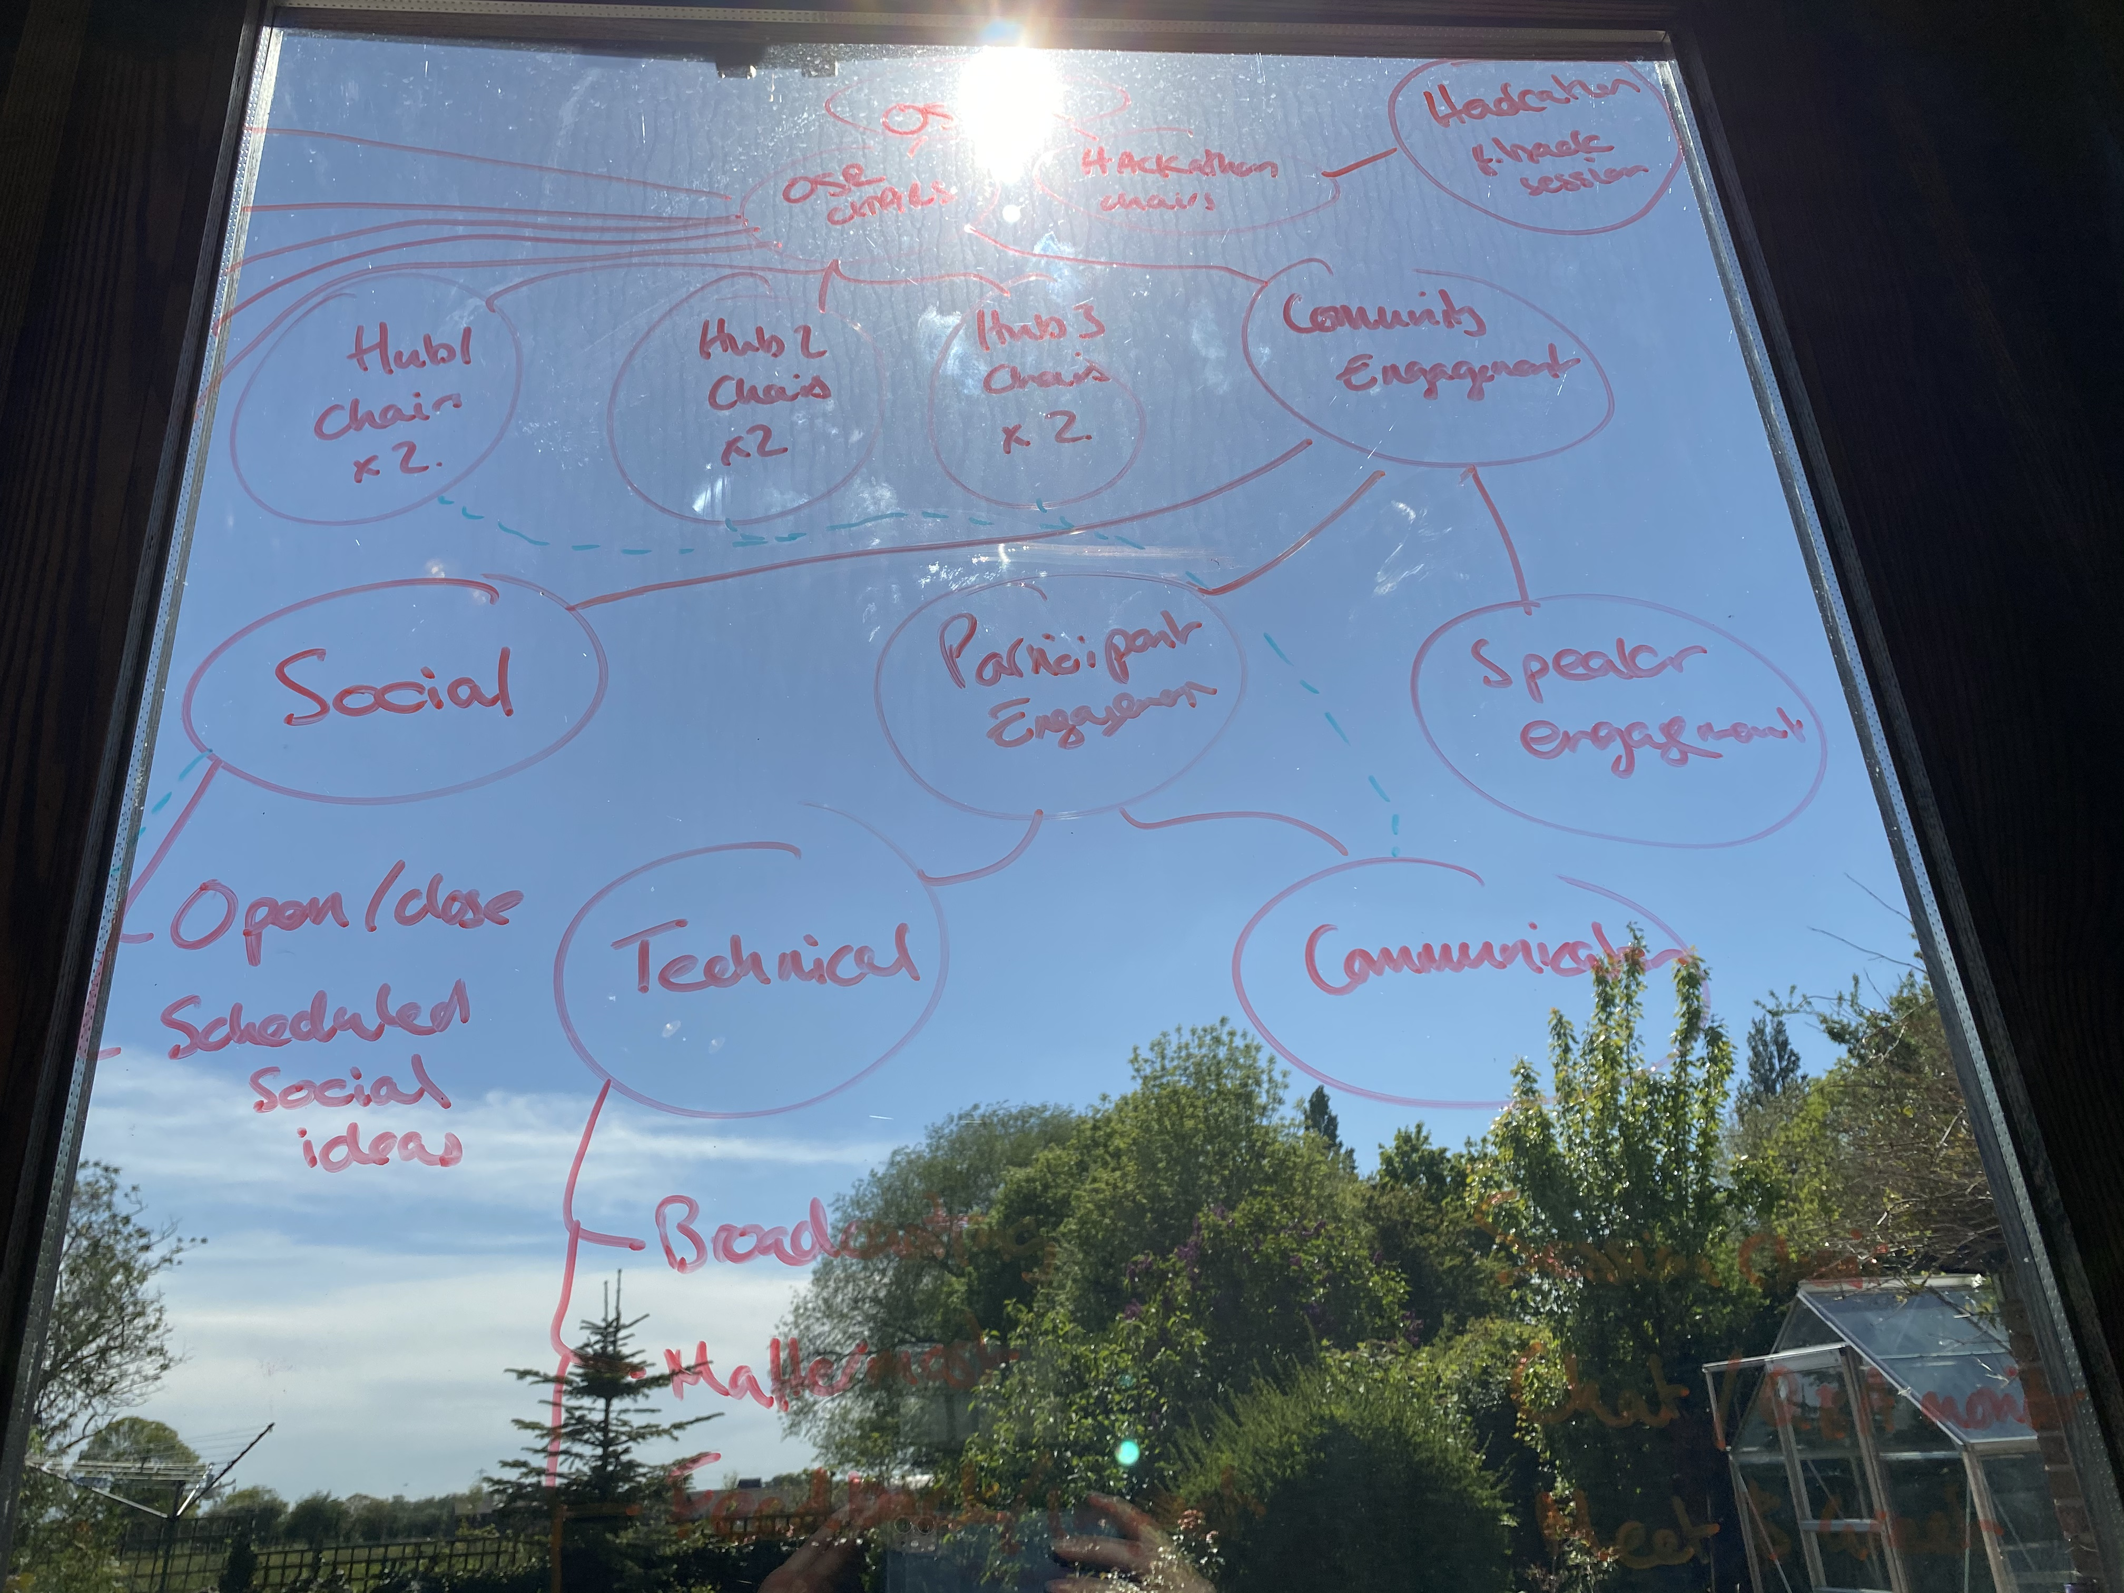
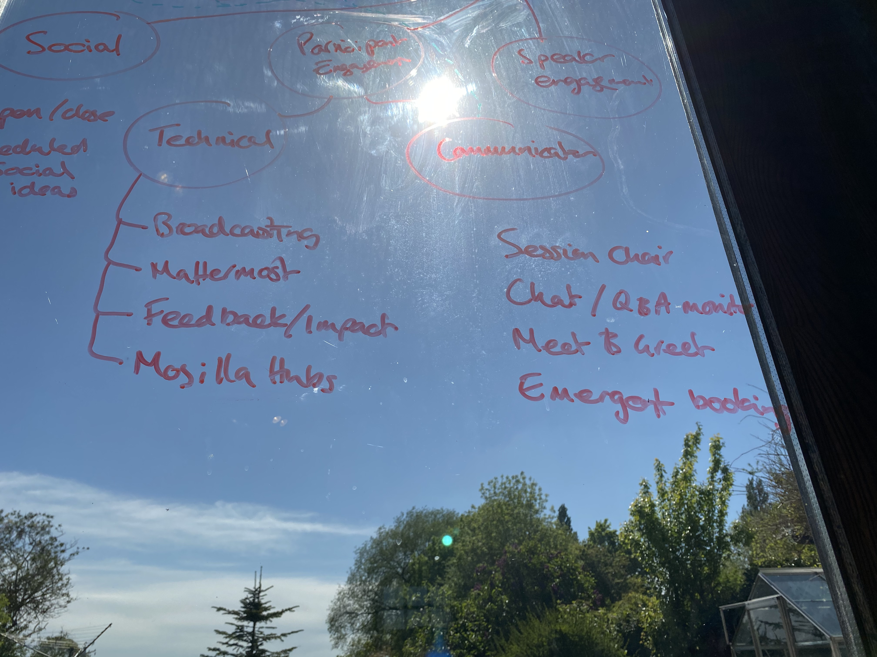

Slide 3
OS-SIG
Hackathon Chairs
Hackathon Update Session
OSR Chairs
Communique design and management
Hub Coordinators
Website
Community Engagement
Open Research Advisors
Branding
Social and Multimedia Reporting
Speaker Engagement
Social Events
Participant Engagement
Social Media
Text Content
(longform)
Technical
Communications
Video / Photographic
Content

